Slide 1

Welcome to Zappos Vendor Training
Schedule
10 am Chime Meet and Greet
10:10 am Zapporo training
11:30 am – Q&A
PLEASE MAKE SURE POP-UP BLOCKERS ARE DISABLED!! ☺

Slide 2
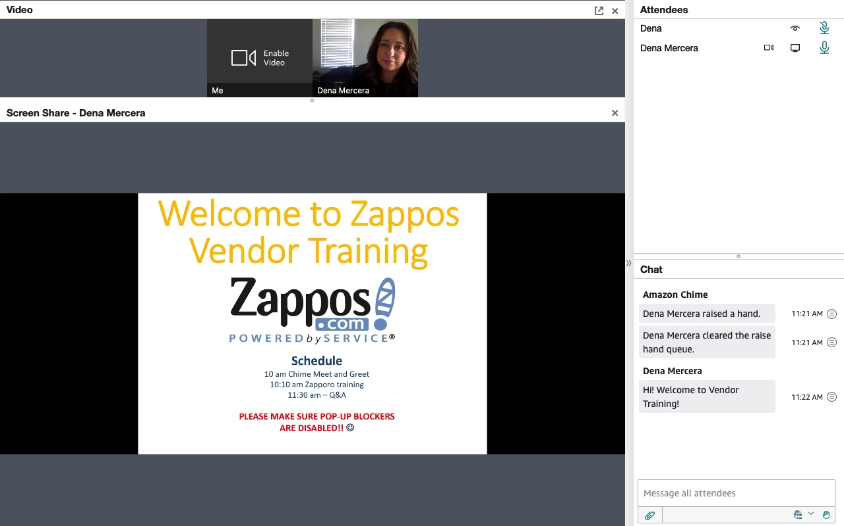
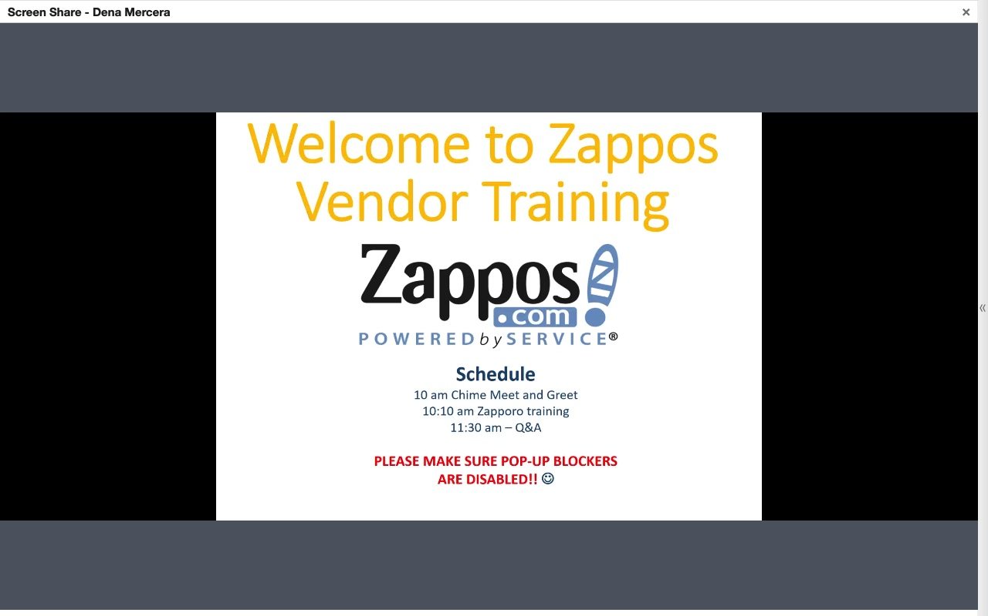
How to maximize your screen

Slide 3

Agenda:
-Log in/Password Reset
-Tips, Tricks and Terms
-Left Hand Navigation Menu
Navigating the Home Page
New Item Set Up Overview
PO List Search
Traffic List Search
Vendor Contacts
Vendor Score Card
Shipped Vendor Report
MESR Report
-Live Demo
Inventory Pages
Creating PO’s
Adding/Editing PO’s
Assisted Replen/ADJ tool
PO Tabs

Slide 4
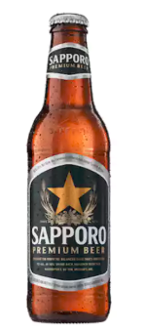

What is Zapporo?
Zapporo stands for: Zappos Purchase Ordering Redefined & Optimized
What is it used for?
Place & Manage Purchase Orders
Manage & Analyze Inventory
Pull Sales Reports

Slide 5


How to login:
2 Methods
1
The Zapporo URL
https://zapporo.zappos.com
2
Zappos.com Search Box Keyword

Slide 6
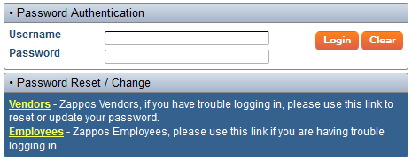
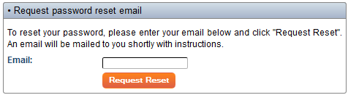
Password Reset
At the logon you can change your password:
1
2
A password reset email link should arrive within 1 hour.

Slide 7


Navigation FYI’s
Each user is assigned to their associated
brand(s) by the Buyer.
The system will log out users after
45 minutes of idleness. (open a new tab
to re-login)
Try to avoid the "back” button,
data may be lost.
Save early and save often!
Preferred browsers: Google Chrome or Mozilla Firefox

Slide 8
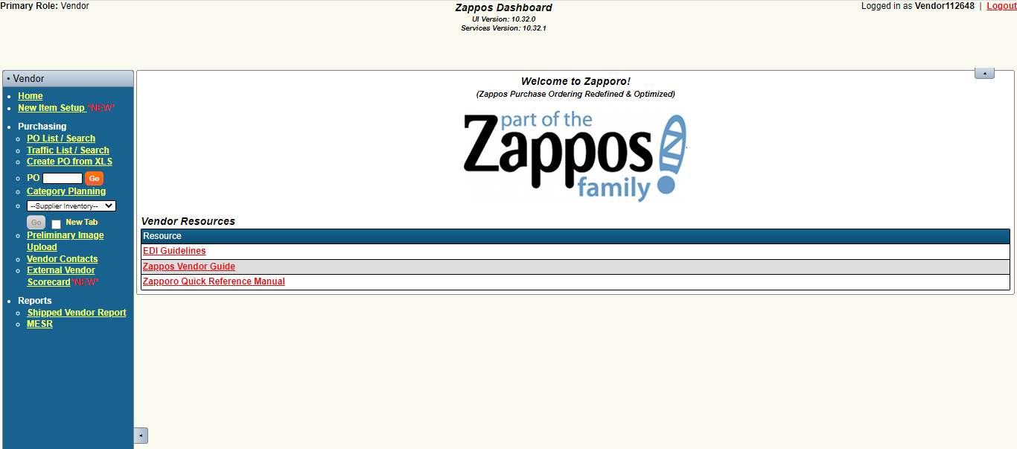
Home Screen and Left Hand Navigation Menu

Slide 9
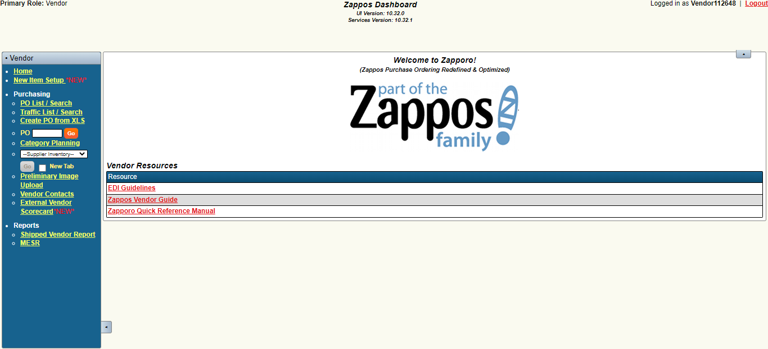
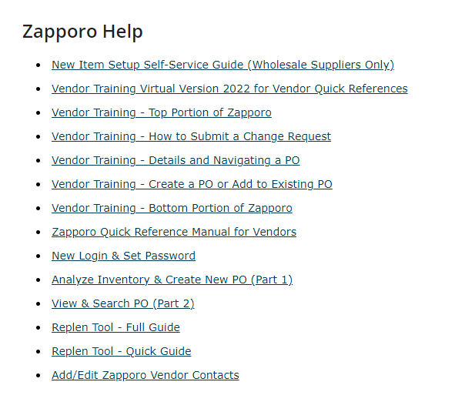
Left Hand Nav: New item Set Up

Slide 10
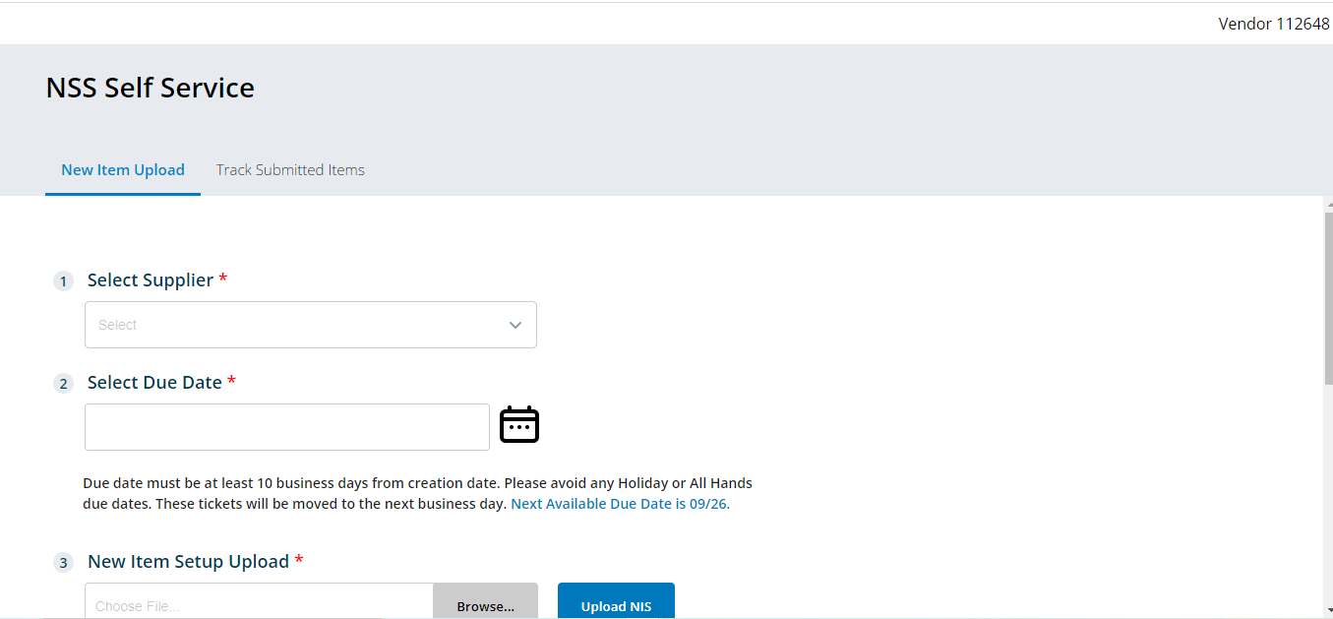
Left Hand Nav: New item Set Up

Slide 11
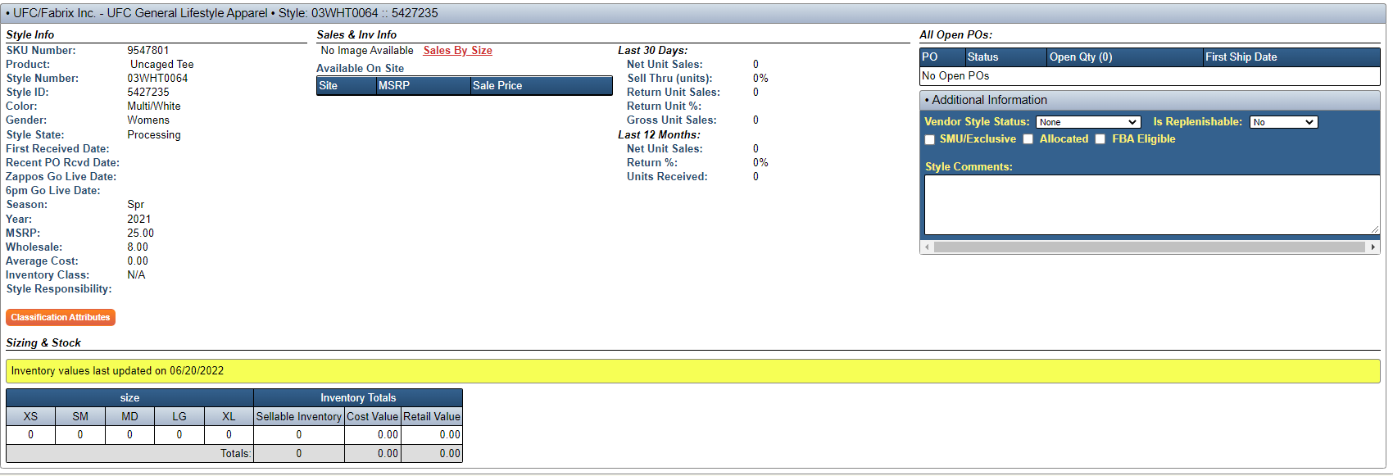
New Item Setup (NIS)
Style Info
SKU Number: | A Zappos generated # that identifies an entire style grouped together by Style Name
Style ID: | A Zappos generated # that is specific to a style # and color combo
Style Name: | Provided by the brand
Style Number: | Provided by the brand
Style State
Processing | Initial state of a style. The SI will live in this state before the product goes live on our site and moves to visible.
Visible | Inventory is received, photographed, description written, and classified. The SI will now be available for purchase on Zappos by our customer.
Hibernate | SI has been moved to our sister site 6PM, for visibility to the 6PM customer to purchase.

Slide 12
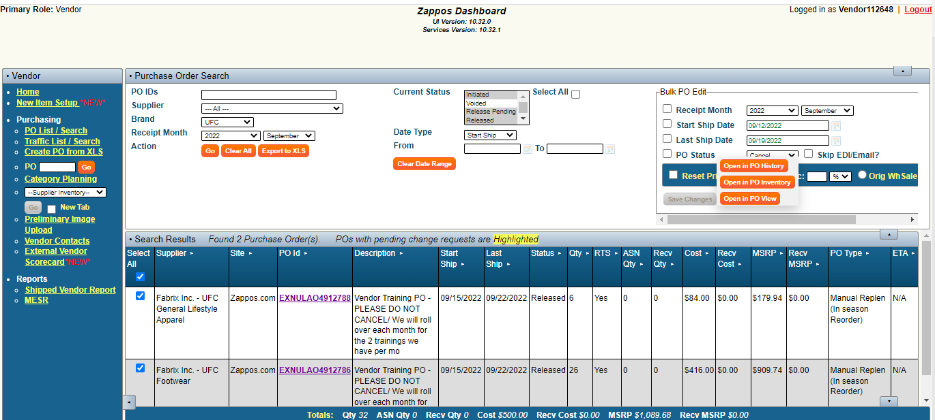
Left Hand Nav: PO List/Search

Slide 13
Purchase Order Types + Ship Windows
Initial Order (Needs Photo) | Use for any NEW styles. *New styles and existing styles cannot be entered on the same purchase order. SHIP WINDOW: Arriving first week of the month is preferred.
Photo PO | Auto generates attached to an Initial PO. Vendors can not adjust these. Changes made to Initial order get mirrored on these. SHIP WINDOW: Arriving two weeks prior Initial PO
Back-up Order (Future Order) | Flowed out orders entered in advance based on projected units (core or seasonal). SHIP WINDOW: Start ship date must be between the 7th and 20th of the receipt month.
Manual Replen (In-season reorder) | In-season reorders based on selling; at-once reorders or fill-ins. SHIP WINDOW: Any time during the receipt month, based on need.
Close-out Order | Used more on 6pm.com, but can be used on Zappos for last pairs in season at a discounted cost. SHIP WINDOW: Any time during the receipt month, based on need.
Seasonal Initial Order | Use for seasonal product that has been received and photographed but it is the first hit of the items season. (ie: core winter boot and the first order for fall is September) SHIP WINDOW: Any time during the receipt month, based on need.
*Our ship windows default to 7 days (with the exception of Photo POs-3weeks).
*If there is ever a business need for an extended ship window or to have a PO hit outside of our designated ship window policies, please reach out to your Buyer!
***PO’s can be routed up to 2 weeks prior to the ship window***

Slide 14
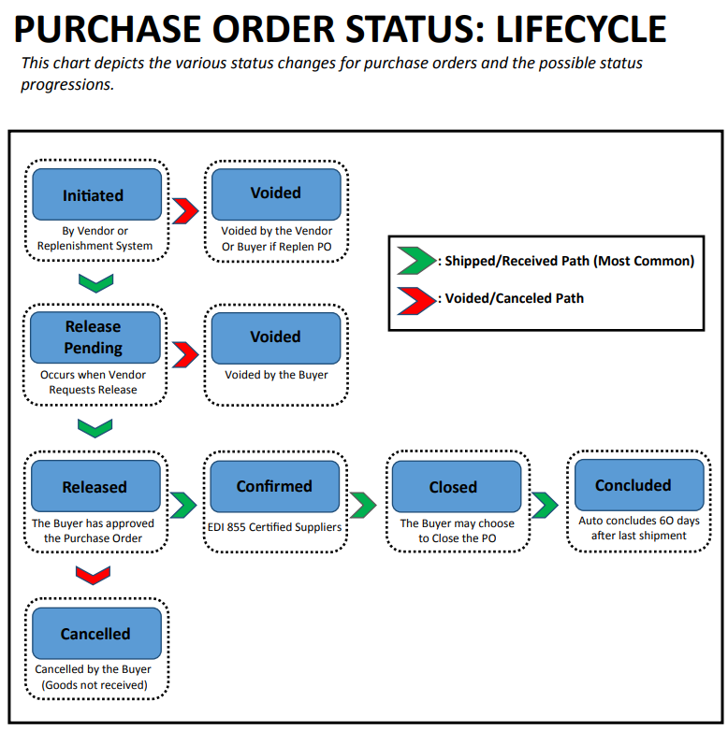
Purchase Order Status
Initiated | PO has been created but not yet released to the Buyer.
Release Pending | PO is awaiting release which is approved by the Buyer.
Voided | Voided after the PO was initiated or Release Pending. *Rule: Cannot be voided after it is ‘released’.
Released | PO has been approved and submitted via EDI as a legally binding document.
Confirmed | Vendor has confirmed receipt of PO.
Cancelled | The order has been cancelled by the Buyer. *Rule: It cannot be reinstated. In the case of erroneous cancellation, a new PO can be issued.
Closed | POs automatically close 14 days after the last ship date. A PO may be closed by the system or by the Buyer.
Concluded | POs are concluded after 60 days from the last ship date. *Rule: The order cannot be reinstated.

Slide 15
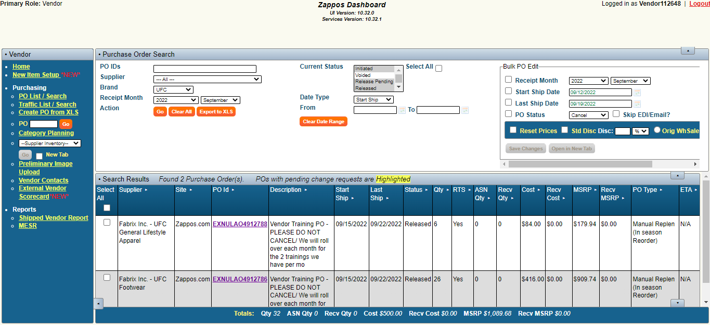
Left Hand Nav: Traffic List/Search

Slide 16
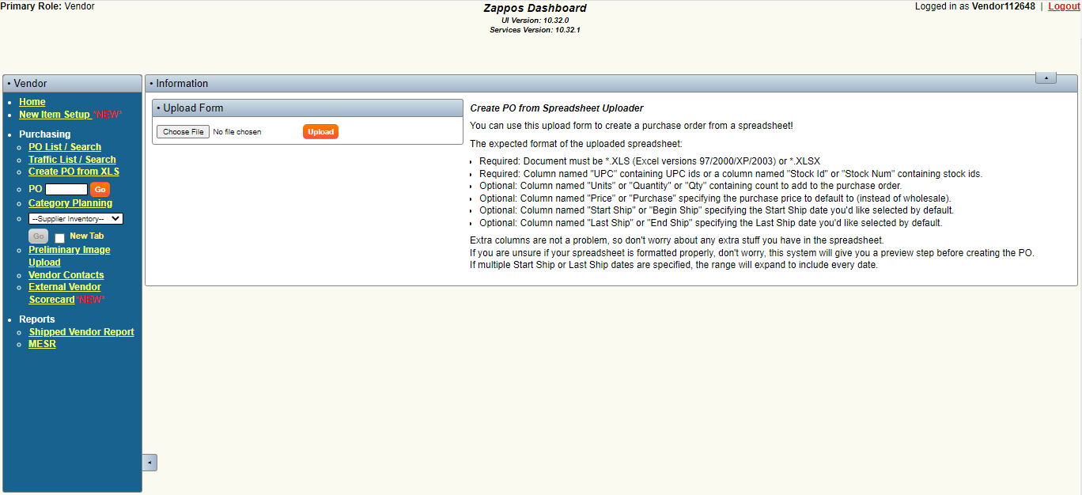
Left Hand Nav: Create PO List from XLS

Slide 17
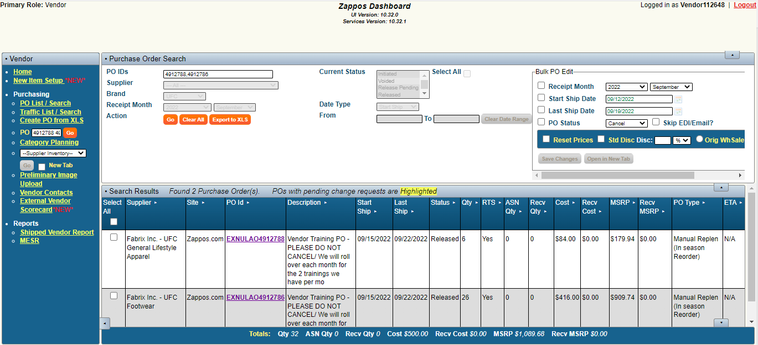
Left Hand Nav: PO Open Search Box

Slide 18
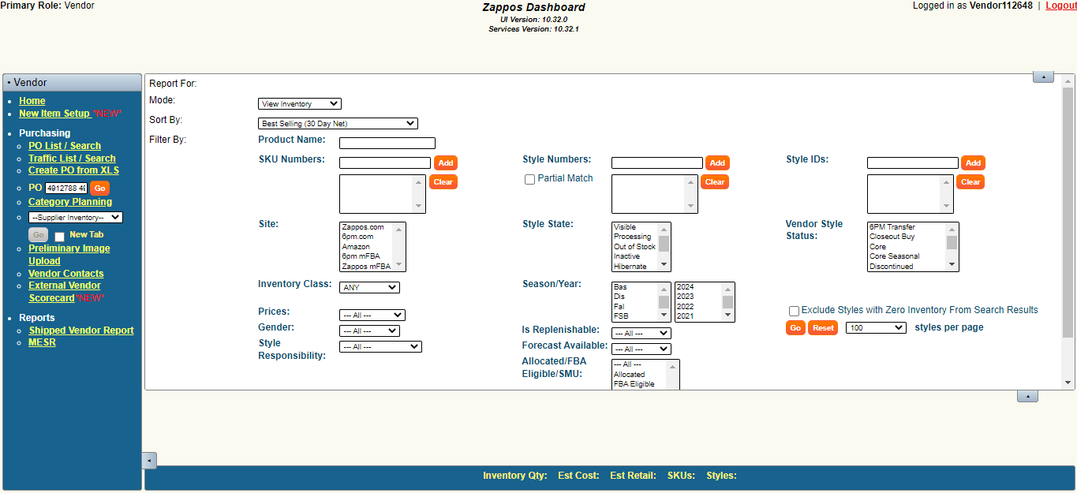
Left Hand Nav: Category Planning

Slide 19
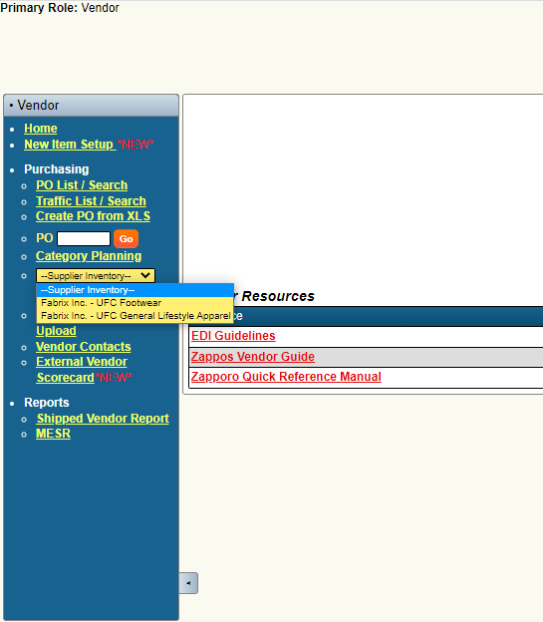
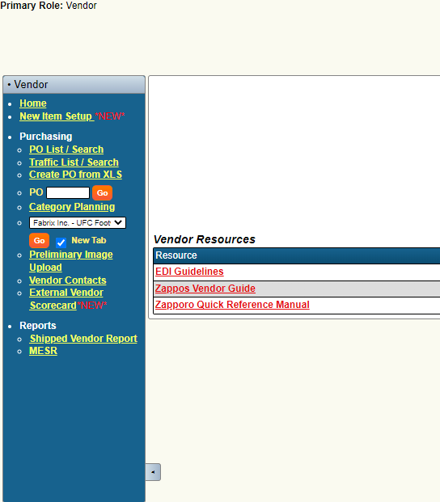
Left Hand Nav: Category Planning

Slide 20
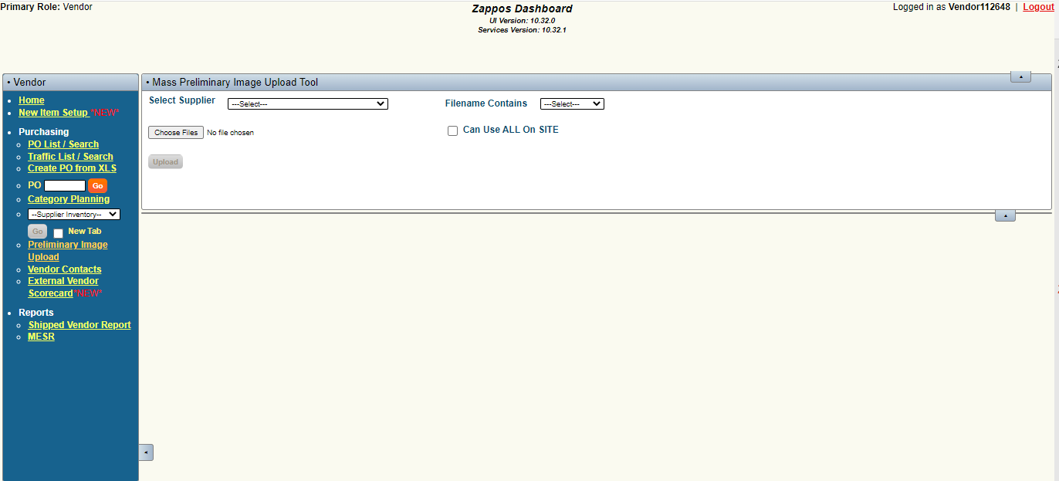

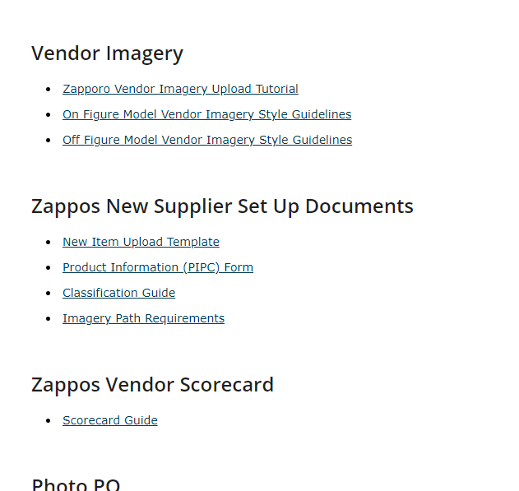
Left Hand Nav: Preliminary Image Upload

Slide 21
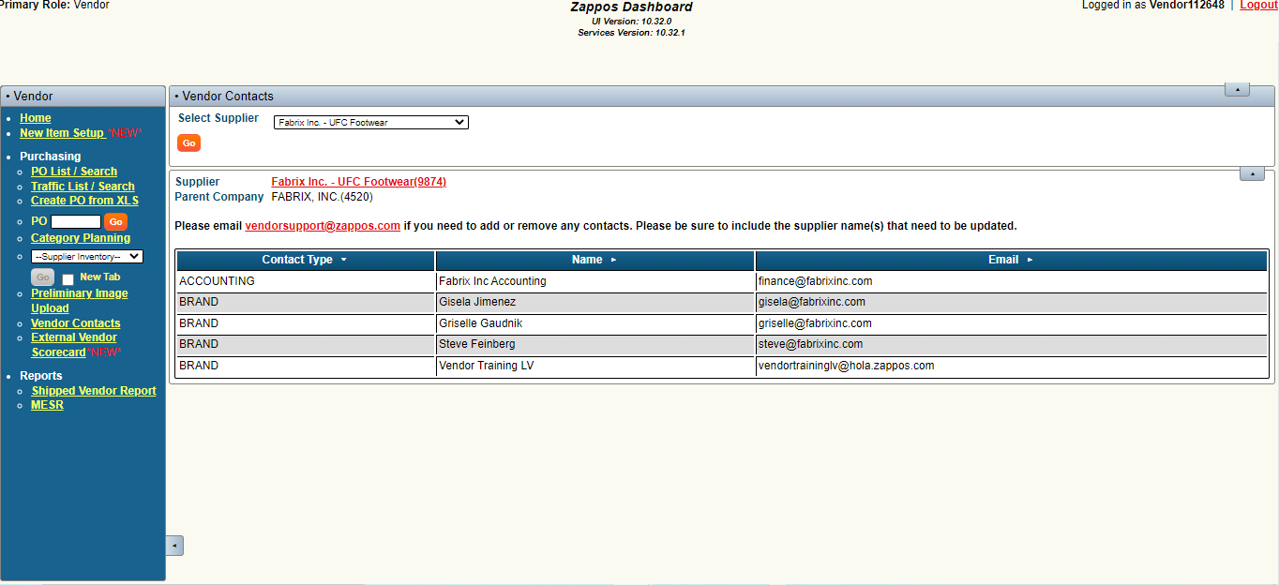
Left Hand Nav: Vendor Contacts

Slide 22
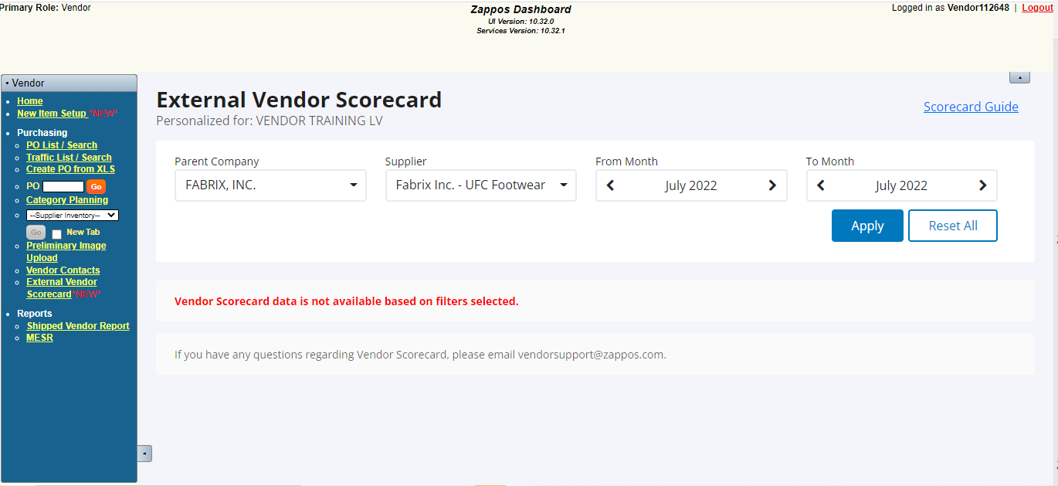
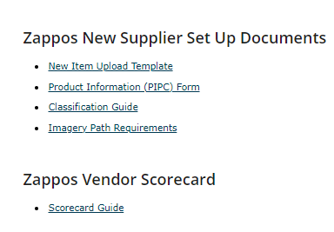
Left Hand Nav: Vendor Scorecard

Slide 23
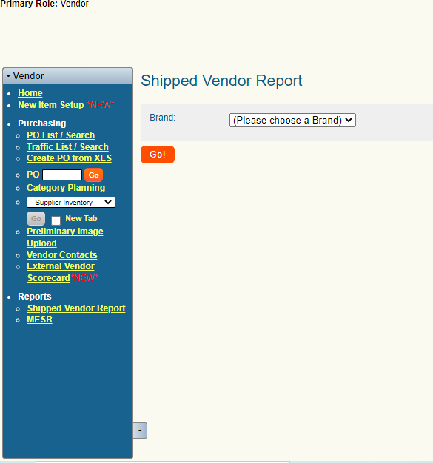
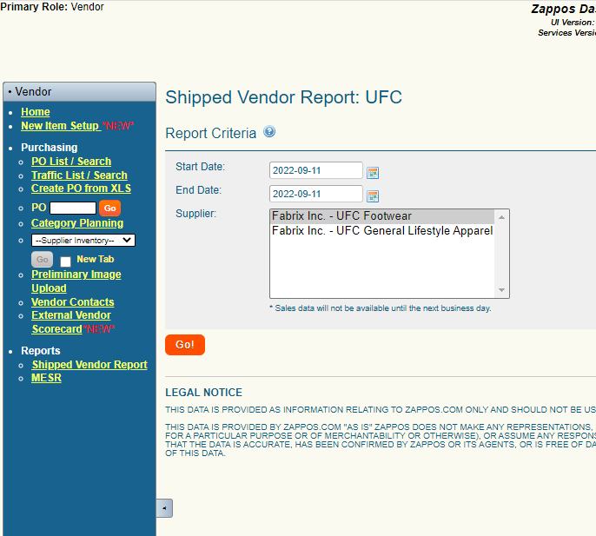
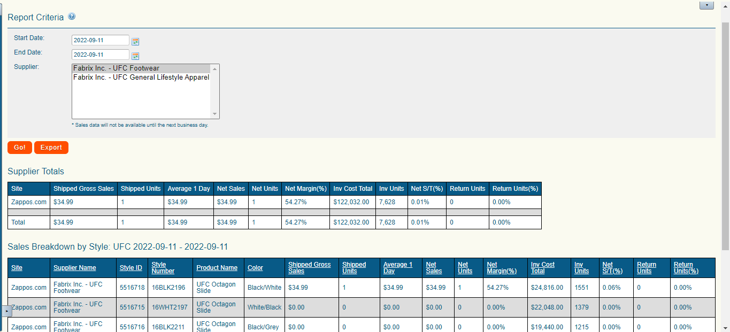
Left Hand Nav: Shipped Vendor Report

Slide 24
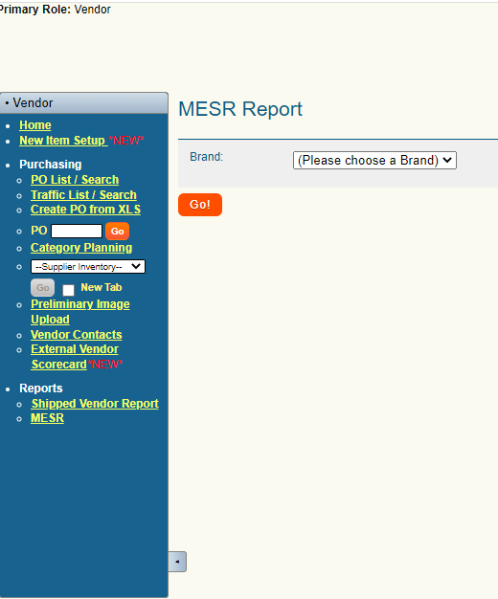
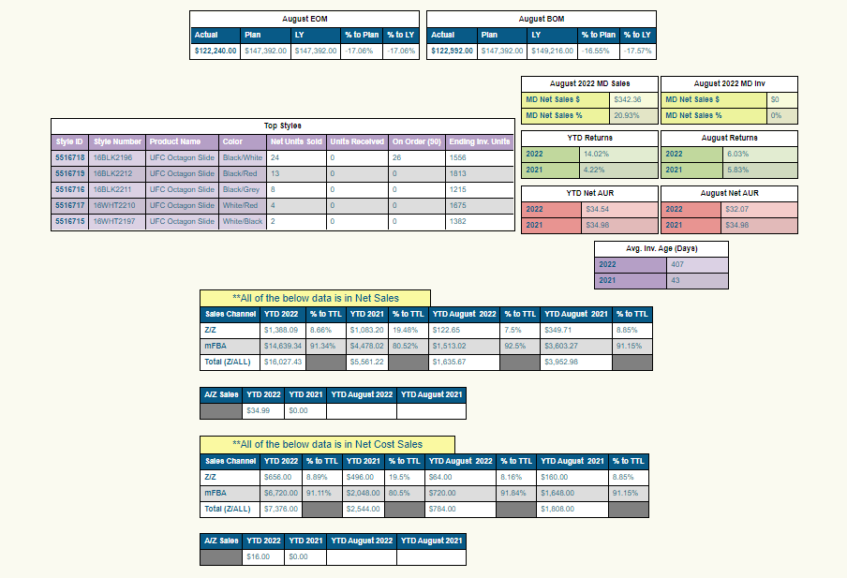
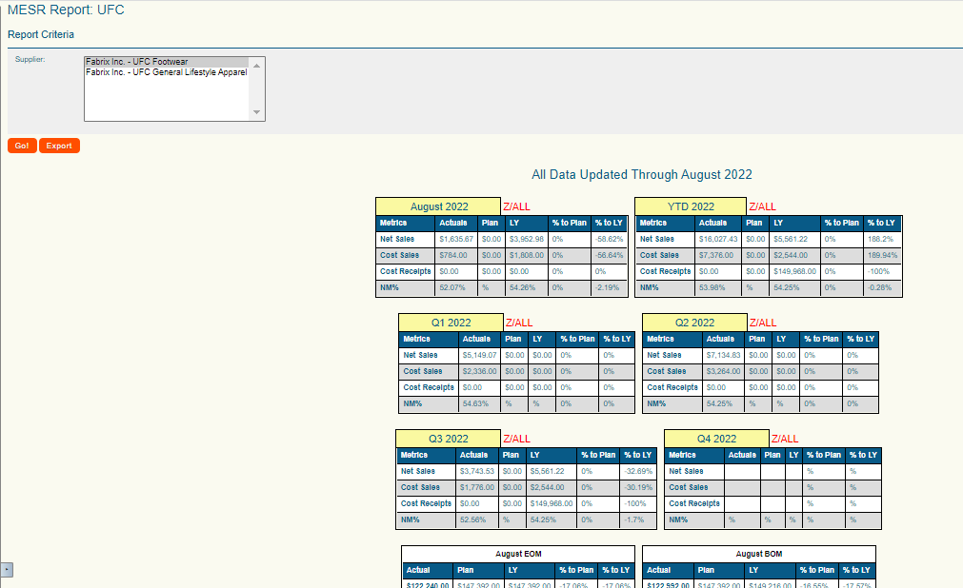
Left Hand Nav: MESR ( Month End Sales Report)

Slide 25

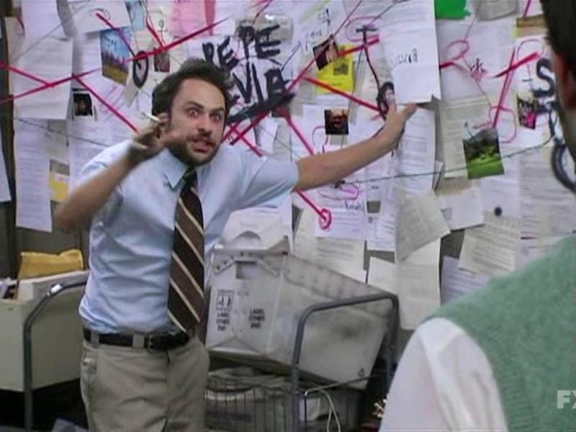

Slide 26

Create PO/ Pending Styles
When creating a PO you will see one of the 2 views below when creating your PO:
If you have under 100 styles you will see the below option:
If you have over 100 styles you will see the button below that states “Move All Edited to Pending”, and a Pending Styles tab:
When adding styles to a PO that has over 100 styles you will need to select the “Move All Edited to Pending” button at the top of each page and then go to the Pending Styles tab where you will have the same 3 buttons at top: Create new PO, Blank All Values and Add to Existing PO

Slide 27
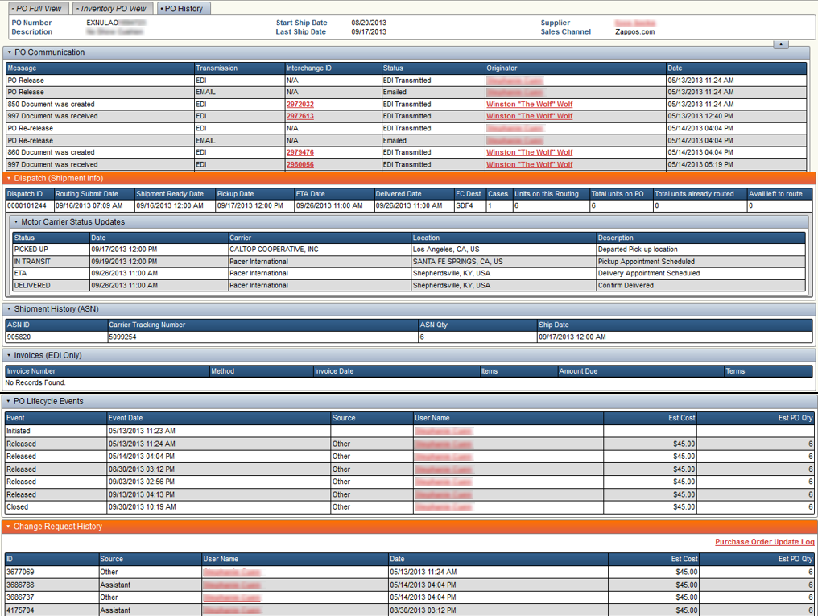
PO History

Slide 28

Change Requests
After a PO has been released, any subsequent changes will be tracked. These are called Change Requests.
Potential changes:
Manual (Vendor)
Add/Remove Items
Price Updates
Ship Date Changes
Automatic (Electronic Data Interchange)
PO Confirmation Change (855 PO Acknowledgment)
ASN discrepancies (856 Advanced Ship Notice)

Slide 30
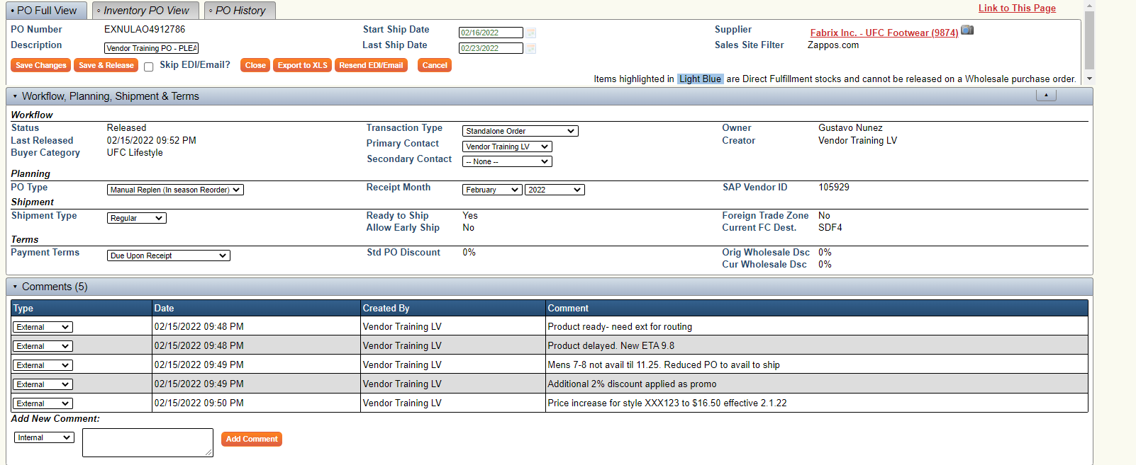
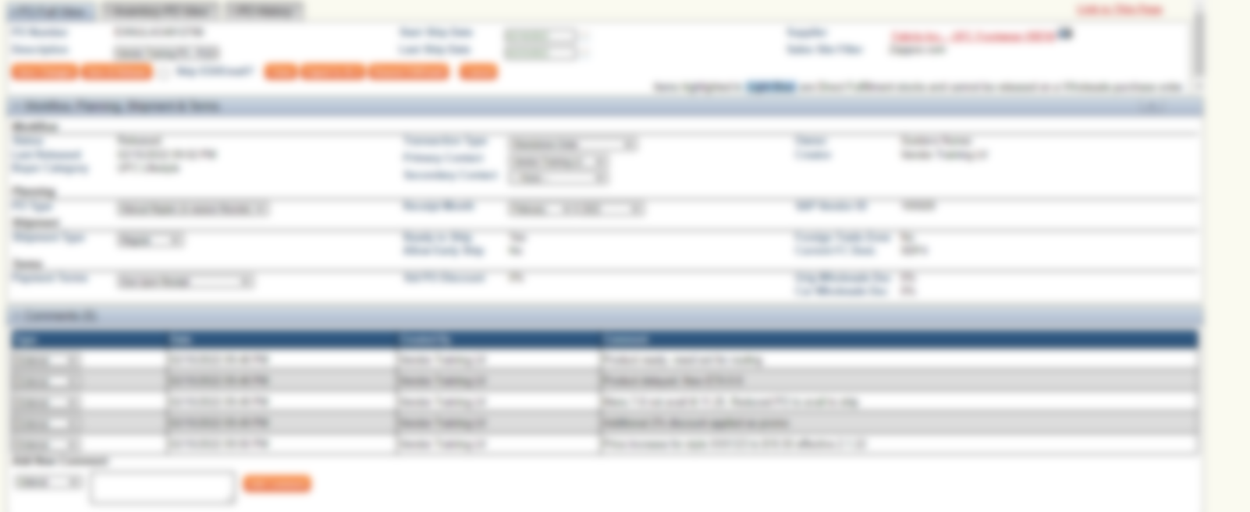
Change Requests: PO Comments Examples

Slide 31

Common Change FAQs
Vendors have the ability to update pricing on a PO, they do not in the system.
Send your price list to your buyer and please make sure it includes the new cost, MSRP and MAP (if applicable) as well as the Zappos Style ID (SI) number.
For any style name, color or style number updates or changes: Send the update to your buyer and please include the Zappos SI #

Slide 32
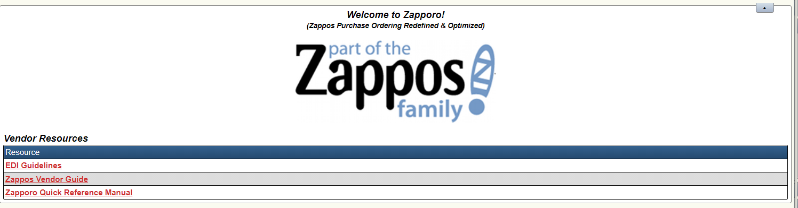
Vendor Resources
Change Requests EDI Guidelines
Zappos Vendor Guide
Zapporo Quick Reference Manual

Slide 33
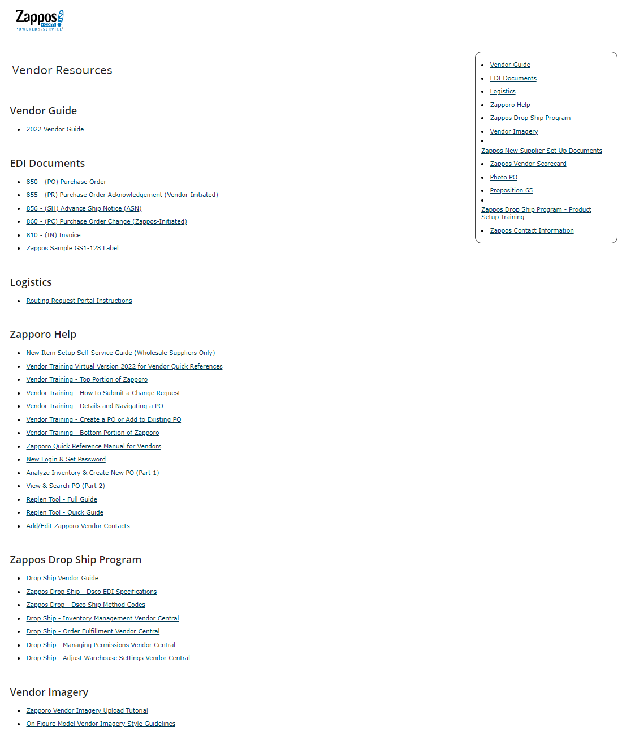
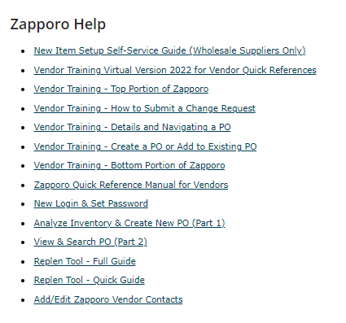
Vendor Resources

Slide 34


Slide 35


Slide 36


Thanks for attending!
Reminder that the “Home” page of Zapporo has a link to the Zapporo Quick Reference Guide and Vendor Resources
We recommend setting up a follow up session with your Buyer to go over specific metrics and best practices with Zapporo
We are also always available should you have any questions
VendorTraining@zappos.com

